Slide 1
Validation methods
Nathaniel Shimoni
PyData Israel 16/2/2017

Slide 2
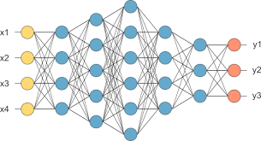
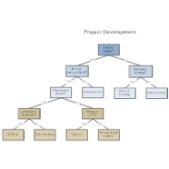





Kfold
Train-test split
leave one out (loo)
Model selection
$$μ, θ, γ, β, α, δ$$
Leave P out
Hyper-parameter tuning
basics
Group Kfold
Early stopping
Why?
Grouped data
Validation techniques
Leave one
group out
Unbalanced data
Time series
Stratified methods
Sliding window
Time based
group Kfold
Anchored sliding window

Slide 3
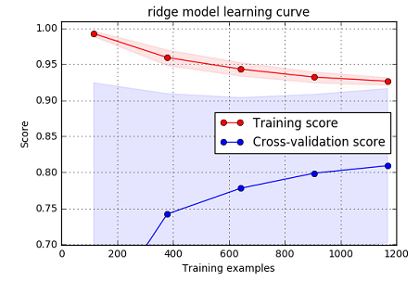
We use validation to balance two things:
Fit our training data as well as we can (while…)
Generalize well to get best performance on unseen data (aka refrain from over-fitting)
We use validation to:
Select best model
Select best hyper-parameters
Early stopping of training process

Slide 4
Kfold
Train-test split
leave one out (loo)
Model selection
$$μ, θ, γ, β, α, δ$$
Leave P out
Hyper-parameter tuning
basics
Group Kfold
Early stopping
Why?
Grouped data
Validation techniques
Leave one
group out
Unbalanced data
Time series
Stratified methods
Sliding window
Time based
group Kfold
Anchored sliding window

Slide 5
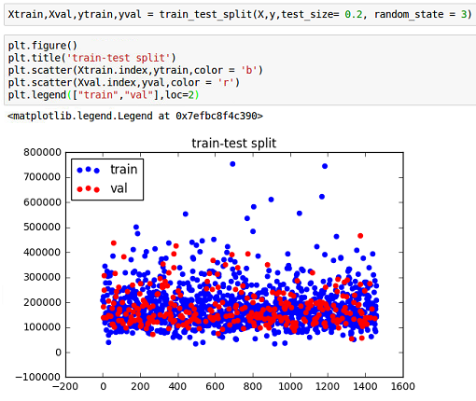
Train test split
The most basic validation technique
It is based on hold-out-sample
We split the training data randomly and test our performance on the unseen data

Slide 6
The train-test split validation method is very common. its main benefits:
computational efficiency
simplicity
but it has two disadvantages:
we’re loosing large amount of data
Might suffer from
skew / bias
Cross Validation
Stratification
Select folds in a way that keeps equal proportion of target variable in each fold

Slide 7
Kfold
Train-test split
leave one out (loo)
Model selection
$$μ, θ, γ, β, α, δ$$
Leave P out
Hyper-parameter tuning
basics
Group Kfold
Early stopping
Why?
Grouped data
Validation techniques
Leave one
group out
Unbalanced data
Time series
Stratified methods
Sliding window
Time based
group Kfold
Anchored sliding window

Slide 8
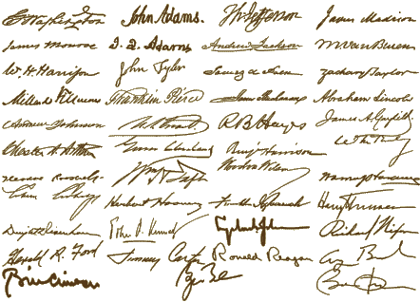
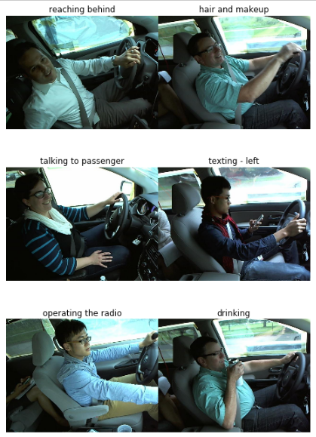

What if the samples are drown from different groups?
Can we retrain for new groups?
Yes
use Kfold /
stratified Kfold
No
use group-based folding methods

Slide 9
Kfold
Train-test split
leave one out (loo)
Model selection
$$μ, θ, γ, β, α, δ$$
Leave P out
Hyper-parameter tuning
basics
Group Kfold
Early stopping
Why?
Grouped data
Validation techniques
Leave one
group out
Unbalanced data
Time series
Stratified methods
Sliding window
Time based
group Kfold
Anchored sliding window

Slide 10
Time series data?
Are we predicting a specific time frame?
Are we predicting future events?
Use time based folds / split
Use sliding window
Use anchored sliding window
Random split is more like an imputation problem

Slide 11
Kfold
Train-test split
leave one out (loo)
Model selection
$$μ, θ, γ, β, α, δ$$
Leave P out
Hyper-parameter tuning
basics
Group Kfold
Early stopping
Why?
Grouped data
Validation techniques
Leave one
group out
Unbalanced data
Time series
Stratified methods
Sliding window
Time based
group Kfold
Anchored sliding window

Slide 12
Thank you !
linkedIn
Github

